Slide 1
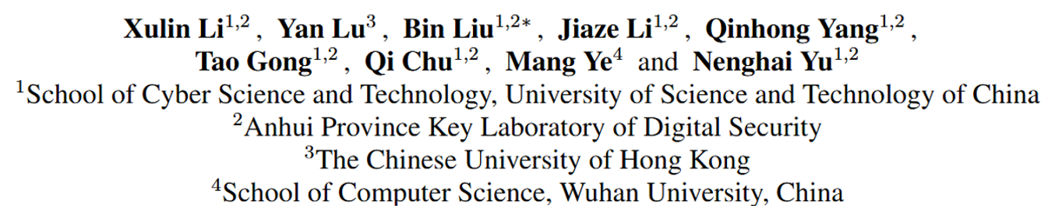


Title
Towards Anytime Retrieval: A Benchmark for
Anytime Person Re-Identification
Towards Anytime Retrieval: A Benchmark for Anytime Person Re-Identification ID: 2068

Slide 2


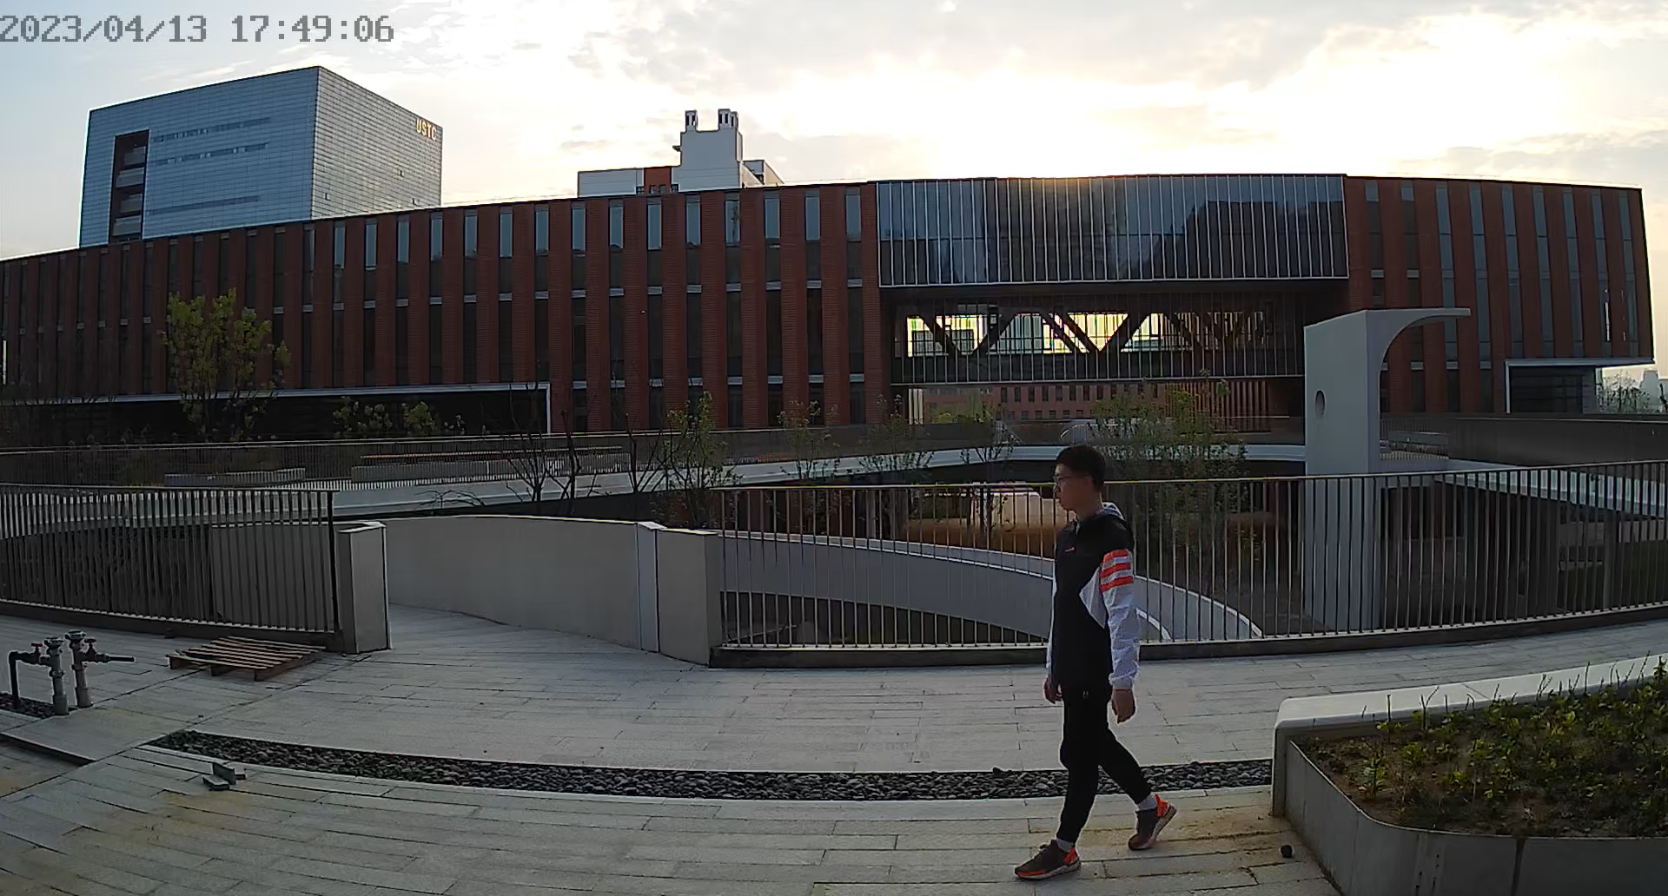
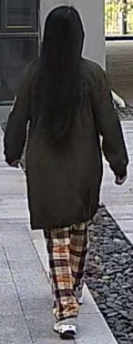

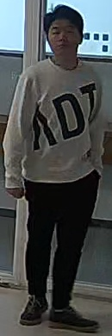
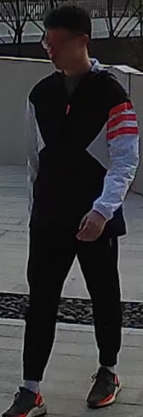

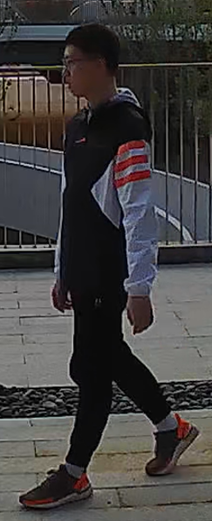
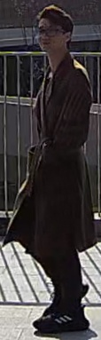
Person Re-ID
Raw Video Frame
Gallery
Query
Rank
Search
Result
Detection
Search
Person re-identification (ReID) aims to retrieve specific pedestrians captured by different cameras.
Towards Anytime Retrieval: A Benchmark for Anytime Person Re-Identification ID: 2068

Slide 3
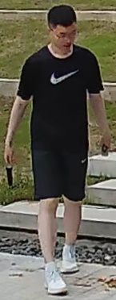
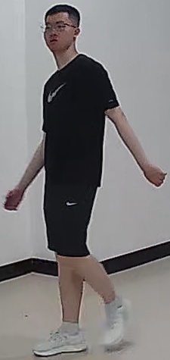
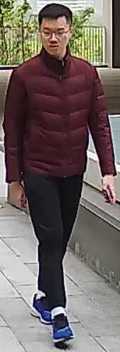
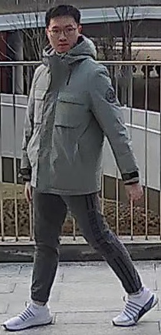
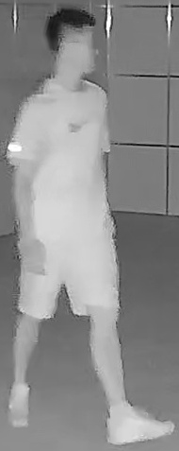
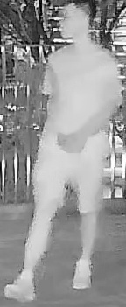
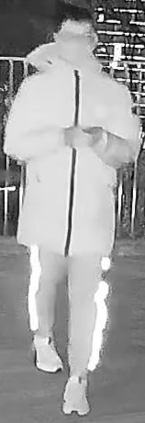
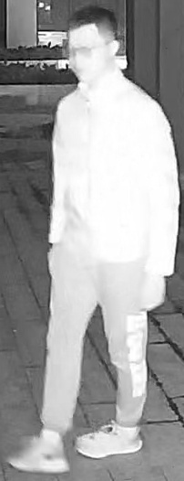
Person Re-ID
Case 1
Day
Case 2
Case 3
Case 4
Spring
Winter
Case 6
Night
Case 5
A robust ReID system is expected to retrieve pedestrians at any time, including daytime and nighttime, ranging from short-term to long-term.
Towards Anytime Retrieval: A Benchmark for Anytime Person Re-Identification ID: 2068

Slide 4


Existing works
Tr-
ReID
Daytime
RGB camera
Scenario : DT-ST
Short-
term
Same clothes
Traditional ReID (Tr-ReID) only achieves short-term retrieval in the RGB modality, which may not perform effectively in real applications.
Towards Anytime Retrieval: A Benchmark for Anytime Person Re-Identification ID: 2068

Slide 5

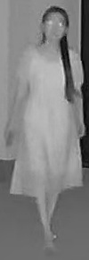
Existing works
CM-ReID
All-day
RGB IR
Scenario : AD-ST
Short-
term
Same clothes
The researchers introduced the Visible-Infrared Cross-Modality ReID (CM-ReID) task to address the issue of searching between daytime RGB images and nighttime infrared (IR) images.
Towards Anytime Retrieval: A Benchmark for Anytime Person Re-Identification ID: 2068

Slide 6


Existing works
CC-ReID
Daytime
RGB camera
Scenario : DT-LT
Long-
term
Clothes
changes
And the Long-Term Cloth-Changing ReID (CC-ReID) task was proposed to handle long-term retrieval in which pedestrians change their clothes.
Towards Anytime Retrieval: A Benchmark for Anytime Person Re-Identification ID: 2068

Slide 7
Existing works
Tr-
ReID
Daytime
CM-ReID
All-day
CC-ReID
Daytime
RGB camera
RGB IR
RGB camera
Scenario : DT-ST
Scenario : AD-ST
Scenario : DT-LT
Short-
term
Short-
term
Long-
term
Same clothes
Same clothes
Clothes
changes
However, existing ReID datasets and methods designed for these specific tasks incapable of retrieving targets at any time simultaneously.
Towards Anytime Retrieval: A Benchmark for Anytime Person Re-Identification ID: 2068

Slide 8
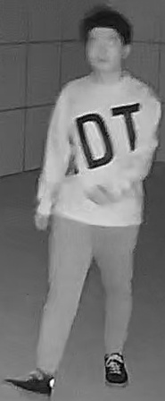
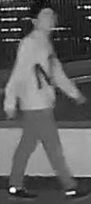
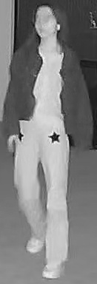
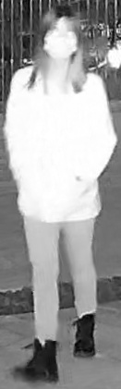
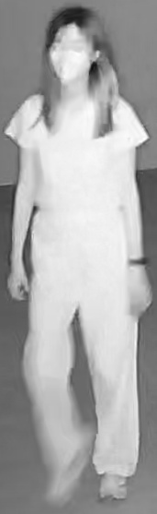
New Task: Anytime Re-ID
AT-
ReID
Daytime
All-day
Nighttime
RGB camera
RGB IR
IR camera
Scenario : DT-ST
Scenario : AD-ST
Scenario : NT-ST
Short-
term
Same clothes
Scenario : DT-LT
Scenario : AD-LT
Scenario : NT-LT
Long-
term
Clothes
changes
In this work, we investigate a new task called Anytime Person Re-identification (AT-ReID), which aims to achieve effective retrieval in multiple scenarios based on variations in time.
Towards Anytime Retrieval: A Benchmark for Anytime Person Re-Identification ID: 2068

Slide 9
New Dataset: AT-USTC
AT-USTC
cam10
AT-USTC
cam11
cam15
cam16
cam9
cam1
cam2
cam14
cam12
cam8
cam7
cam3
cam5
cam6
cam13
cam4
Day
Scene
Night
Scene
Building or Room
RGB
IR
To address the AT-ReID problem, we collect the first large-scale dataset, AT-USTC, which covers all 6 scenarios in AT-ReID.
Towards Anytime Retrieval: A Benchmark for Anytime Person Re-Identification ID: 2068

Slide 10
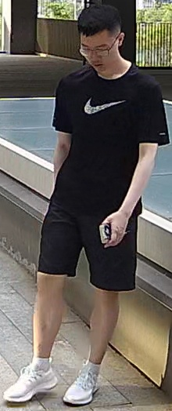
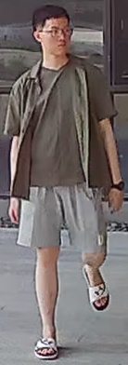
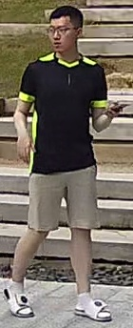

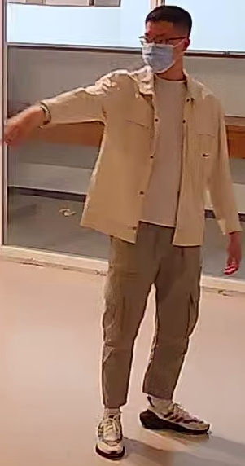

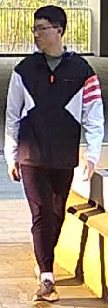
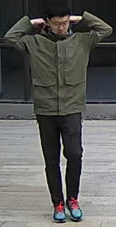


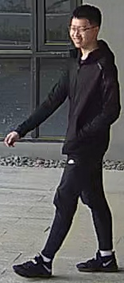



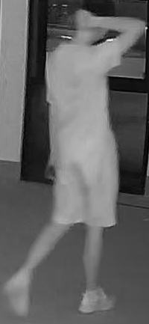
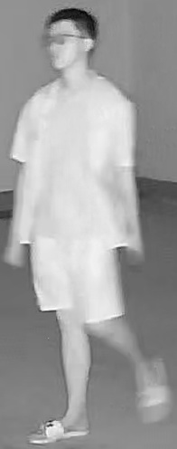
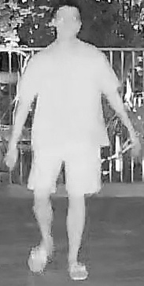
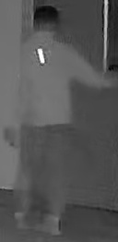
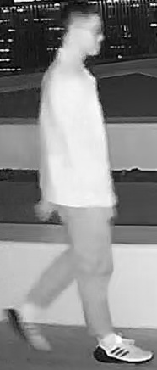
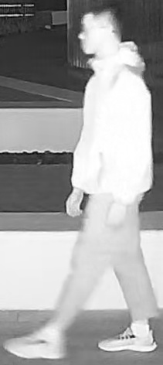
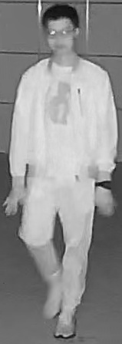
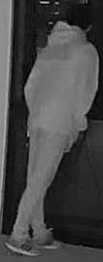
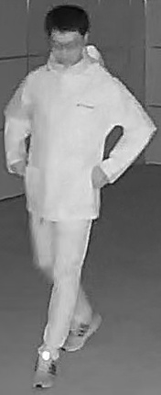
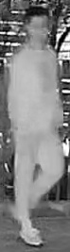
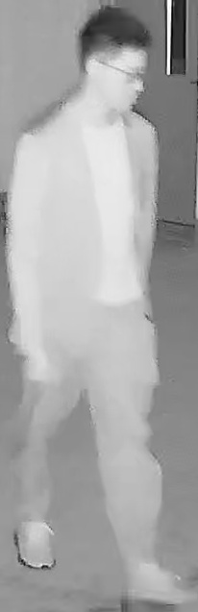
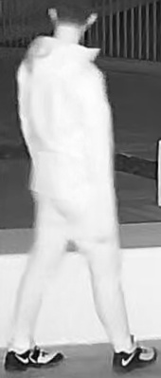
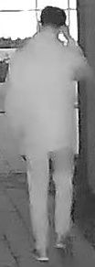
New Dataset: AT-USTC
Summer Spring Winter
AT-USTC
Avg Capture Times/Videos Per Person: 29.1
Our data collection spans over an entire year and 270 volunteers were photographed on average 29.1 times across different dates or scenes, 4-15 times more than current datasets, providing conditions for investigations in AT-ReID.
Towards Anytime Retrieval: A Benchmark for Anytime Person Re-Identification ID: 2068

Slide 11








New Multi-Task Method: Uni-AT
Scenario-Aware Identity Loss
Patch
Token
Scenario Head
Weighted
sum
*
*
*
Gating
Task2
Task3
*
Scenario
CLS Token
Position
Embedding
…
*
*
Expert
FFN
MoAE
*
Select
…
*
Transformer Layer
*
*
Confidence
(Time Interval)
…
Norm
Transformer Layer
[ DT ]
*
DT-ST
…
…
[ NT ]
…
…
Confidence
(Time Moment)
0
*
1
*
5
*
6
7
8
13
Self-Attention
Task1
[ AD ]
*
Linear Projection
NT-ST
Norm
…
…
[ ST ]
Loss weight
…
*
*
*
*
[ LT ]
AD-LT
AT-USTC
Dataset
Attribute
layers
Experts
(FFN)
Hierarchical Dynamic Weighting (HDW)
Multi-Scenario ReID (MS-ReID)
Mixture-of-Attribute-
Experts (MoAE)
To tackle the new challenge of multi-scenario retrieval, we propose a unified model named Uni-AT.
Towards Anytime Retrieval: A Benchmark for Anytime Person Re-Identification ID: 2068

Slide 12
New Multi-Task Method: Uni-AT
Scenario-Aware Identity Loss
Patch
Token
Scenario Head
Weighted
sum
*
*
*
Gating
Task2
Task3
*
Scenario
CLS Token
Position
Embedding
…
*
*
Expert
FFN
MoAE
*
Select
…
*
Transformer Layer
*
*
Confidence
(Time Interval)
…
Norm
Transformer Layer
[ DT ]
*
DT-ST
…
…
[ NT ]
…
…
Confidence
(Time Moment)
0
*
1
*
5
*
6
7
8
13
Self-Attention
Task1
[ AD ]
*
Linear Projection
NT-ST
Norm
…
…
[ ST ]
Loss weight
…
*
*
*
*
[ LT ]
AD-LT
AT-USTC
Dataset
Attribute
layers
Experts
(FFN)
Hierarchical Dynamic Weighting (HDW)
Multi-Scenario ReID (MS-ReID)
Mixture-of-Attribute-
Experts (MoAE)
We propose a Multi-scenario ReID framework. 6 CLS tokens extract different features for different scenarios separately to capture specific clues in each scenario.
Towards Anytime Retrieval: A Benchmark for Anytime Person Re-Identification ID: 2068

Slide 13
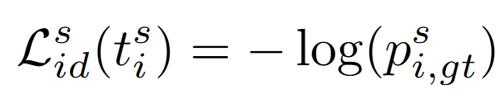
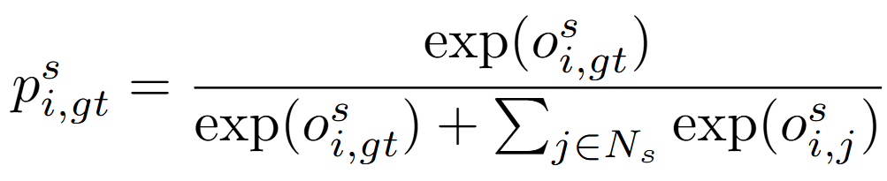
New Multi-Task Method: Uni-AT
Scenario-Aware Identity Loss
Patch
Token
Scenario Head
Weighted
sum
*
*
*
Gating
Task2
Task3
*
Scenario
CLS Token
Position
Embedding
…
*
*
Expert
FFN
MoAE
*
Select
…
*
Transformer Layer
*
*
Confidence
(Time Interval)
…
Norm
Transformer Layer
[ DT ]
*
DT-ST
…
…
[ NT ]
…
…
Confidence
(Time Moment)
0
*
1
*
5
*
6
7
8
13
Self-Attention
Task1
[ AD ]
*
Linear Projection
NT-ST
Norm
…
…
[ ST ]
Loss weight
…
*
*
*
*
[ LT ]
AD-LT
AT-USTC
Dataset
Attribute
layers
Experts
(FFN)
Hierarchical Dynamic Weighting (HDW)
Multi-Scenario ReID (MS-ReID)
Mixture-of-Attribute-
Experts (MoAE)
And a scenario-aware identity loss is proposed to train the model. Different scenarios have non-shared classifiers, distinct negative category sets, and different modality filtering mechanisms.
Towards Anytime Retrieval: A Benchmark for Anytime Person Re-Identification ID: 2068

Slide 14
New Multi-Task Method: Uni-AT
Scenario-Aware Identity Loss
Patch
Token
Scenario Head
Weighted
sum
*
*
*
Gating
Task2
Task3
*
Scenario
CLS Token
Position
Embedding
…
*
*
Expert
FFN
MoAE
*
Select
…
*
Transformer Layer
*
*
Confidence
(Time Interval)
…
Norm
Transformer Layer
[ DT ]
*
DT-ST
…
…
[ NT ]
…
…
Confidence
(Time Moment)
0
*
1
*
5
*
6
7
8
13
Self-Attention
Task1
[ AD ]
*
Linear Projection
NT-ST
Norm
…
…
[ ST ]
Loss weight
…
*
*
*
*
[ LT ]
AD-LT
AT-USTC
Dataset
Attribute
layers
Experts
(FFN)
Hierarchical Dynamic Weighting (HDW)
Multi-Scenario ReID (MS-ReID)
Mixture-of-Attribute-
Experts (MoAE)
We propose a Mixture-of-Attribute-Experts that builds the expert network and assigns different experts to address distinct scenarios, enabling the model to alleviate interference between scenarios.
Towards Anytime Retrieval: A Benchmark for Anytime Person Re-Identification ID: 2068

Slide 15
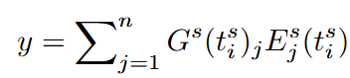
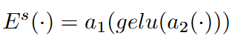
New Multi-Task Method: Uni-AT
Scenario-Aware Identity Loss
Patch
Token
Scenario Head
Weighted
sum
*
*
*
Gating
Task2
Task3
*
Scenario
CLS Token
Position
Embedding
…
*
*
Expert
FFN
MoAE
*
Select
…
*
Transformer Layer
*
*
Confidence
(Time Interval)
…
Norm
Transformer Layer
[ DT ]
*
DT-ST
…
…
[ NT ]
…
…
Confidence
(Time Moment)
0
*
1
*
5
*
6
7
8
13
Self-Attention
Task1
[ AD ]
*
Linear Projection
NT-ST
Norm
…
…
[ ST ]
Loss weight
…
*
*
*
*
[ LT ]
AD-LT
AT-USTC
Dataset
Attribute
layers
Experts
(FFN)
Hierarchical Dynamic Weighting (HDW)
Multi-Scenario ReID (MS-ReID)
Mixture-of-Attribute-
Experts (MoAE)
The idea of MoAE is to incorporate task relations during expert construction to facilitate more effective expert sharing. With this, the model can benefit from multiple related scenarios.
Towards Anytime Retrieval: A Benchmark for Anytime Person Re-Identification ID: 2068

Slide 16
New Multi-Task Method: Uni-AT
Scenario-Aware Identity Loss
Patch
Token
Scenario Head
Weighted
sum
*
*
*
Gating
Task2
Task3
*
Scenario
CLS Token
Position
Embedding
…
*
*
Expert
FFN
MoAE
*
Select
…
*
Transformer Layer
*
*
Confidence
(Time Interval)
…
Norm
Transformer Layer
[ DT ]
*
DT-ST
…
…
[ NT ]
…
…
Confidence
(Time Moment)
0
*
1
*
5
*
6
7
8
13
Self-Attention
Task1
[ AD ]
*
Linear Projection
NT-ST
Norm
…
…
[ ST ]
Loss weight
…
*
*
*
*
[ LT ]
AD-LT
AT-USTC
Dataset
Attribute
layers
Experts
(FFN)
Hierarchical Dynamic Weighting (HDW)
Multi-Scenario ReID (MS-ReID)
Mixture-of-Attribute-
Experts (MoAE)
We propose a Hierarchical Dynamic Weighting method to balance the training for different scenarios with a loss weighting scheme, which considers multiple relevant tasks when computing weights.
Towards Anytime Retrieval: A Benchmark for Anytime Person Re-Identification ID: 2068

Slide 17
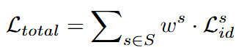
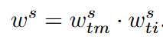
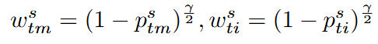
New Multi-Task Method: Uni-AT
Scenario-Aware Identity Loss
Patch
Token
Scenario Head
Weighted
sum
*
*
*
Gating
Task2
Task3
*
Scenario
CLS Token
Position
Embedding
…
*
*
Expert
FFN
MoAE
*
Select
…
*
Transformer Layer
*
*
Confidence
(Time Interval)
…
Norm
Transformer Layer
[ DT ]
*
DT-ST
…
…
[ NT ]
…
…
Confidence
(Time Moment)
0
*
1
*
5
*
6
7
8
13
Self-Attention
Task1
[ AD ]
*
Linear Projection
NT-ST
Norm
…
…
[ ST ]
Loss weight
…
*
*
*
*
[ LT ]
AD-LT
AT-USTC
Dataset
Attribute
layers
Experts
(FFN)
Hierarchical Dynamic Weighting (HDW)
Multi-Scenario ReID (MS-ReID)
Mixture-of-Attribute-
Experts (MoAE)
The idea of HDW is that, when one type of scenarios, e.g., DT-ST scenario, predicts corresponding images with low confidence, we increase their contribution to the loss of all DT-related and ST-related scenarios.
Towards Anytime Retrieval: A Benchmark for Anytime Person Re-Identification ID: 2068

Slide 18
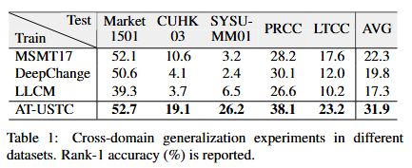
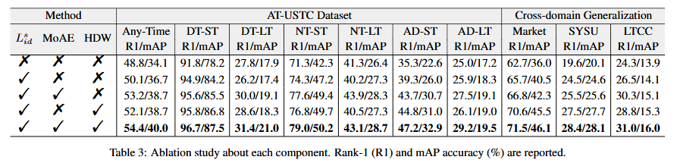
Experiments
Extensive experiments show that our dataset and method lead to satisfactory results …
Towards Anytime Retrieval: A Benchmark for Anytime Person Re-Identification ID: 2068

Slide 19






Experiments
Scenario
DT-ST : Daytime Short-term
Scenario
NT-ST : Nighttime Short-term
Scenario
AD-ST : All-day Short-term
Method
Query
Rank-1
Rank-2
Rank-3
Rank-4
Rank-5
Rank-6
Rank-7
Method
Query
Rank-1
Rank-2
Rank-3
Rank-4
Rank-5
Rank-6
Rank-7
Method
Query
Rank-1
Rank-2
Rank-3
Rank-4
Rank-5
Rank-6
Rank-7
Baseline
Baseline
Baseline
Uni-AT
(Ours)
Uni-AT
(Ours)
Uni-AT
(Ours)
Scenario
DT-LT : Daytime Long-term
Scenario
NT-LT : Nighttime Long-term
Scenario
AD-LT : All-day Long-term
Method
Query
Rank-1
Rank-2
Rank-3
Rank-4
Rank-5
Rank-6
Rank-7
Method
Query
Rank-1
Rank-2
Rank-3
Rank-4
Rank-5
Rank-6
Rank-7
Method
Query
Rank-1
Rank-2
Rank-3
Rank-4
Rank-5
Rank-6
Rank-7
Baseline
Baseline
Baseline
Uni-AT
(Ours)
Uni-AT
(Ours)
Uni-AT
(Ours)
… and exhibits excellent generalization to all scenarios.
Towards Anytime Retrieval: A Benchmark for Anytime Person Re-Identification ID: 2068

Slide 20
Conclusion
Uni-AT method
Multi-scenario learning
AT-USTC dataset
Cover all scenarios
DT-ST
DT-LT
AD-ST
AD-LT
NT-ST
NT-LT
AT-ReID task
Anytime retrieval
Tr-ReID
CC-ReID
CM-ReID
absent
absent
absent
We investigate a new task called AT-ReID, which aims to retrieval at day and night and across different time intervals.
To address the AT-ReID problem, we propose to focus on investigating it from the dataset to the model level.
Towards Anytime Retrieval: A Benchmark for Anytime Person Re-Identification ID: 2068

Slide 21
Conclusion
Thank you
Towards Anytime Retrieval: A Benchmark for Anytime Person Re-Identification ID: 2068

